Slide 1

Real-Time Embedded Digital Signal Processing
Presentation 9
Frequency Analysis & FFT
(Book Ref: Chapter 5)
  Dipu Ghosh, MSEE, MBA.
  Founder & Instructor
  VidyaConnect
  DGhosh@VidyaConnect.com
Notes:
Hello everyone. In this presentation we will study frequency analysis and the Fast Fourier Transform.
The material in this presentation is from chapter 5 of your book.

Slide 2
Learning Objectives
Learning Objectives:
  Analyze periodic signals using the Fourier series.
  Analyze aperiodic signals using the DFT.
  Compute the DFT using the FFT
  Write programs for DFT calculations.
Notes:
Learning objectives are to be able to perform frequency analysis using the Fourier series and the DFT, apply FFT techniques, and implement DFT programs.

Slide 3

Periodic Signals
Notes:
We will start with the study of periodic signals. Periodic signals need special consideration during analysis whether in the time or frequency domain.

Slide 4
Fourier Series
Fourier series of an analog periodic signal x(t) with period T (and fundamental frequency ν) is:
Inverse Fourier series formula:
Notes:
Periodic analog signals x(t) can be represented by a Fourier series as shown here. The Fourier coefficients can be determined by integrating over one period.

Slide 5
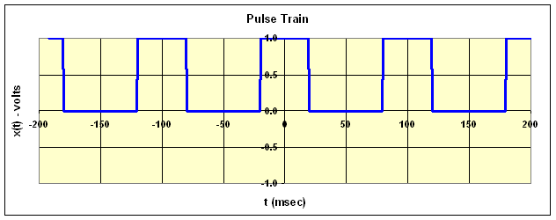
Rectangular Pulse Train
Consider a rectangular pulse train of period T=100 ms, and pulse width τ=40 ms, and amplitude A=1 volt:
Notes:
Lets examine a particular periodic signal – the rectangular pulse train.

Slide 6
Rectangular Pulse Train
Fourier coefficients are:
Notes:
Here is the derivation for the Fourier coefficients. Notice that as k→0, sin(kντ/2)→kντ/2, and ck→Aτ/T. This is the largest of the coefficients and represents the so-called “DC” component of the signal. Notice also that ck=0 for all terms where kπτ/T is a multiple of π, since sinθ=0 for all θ that are multiples of π.

Slide 7
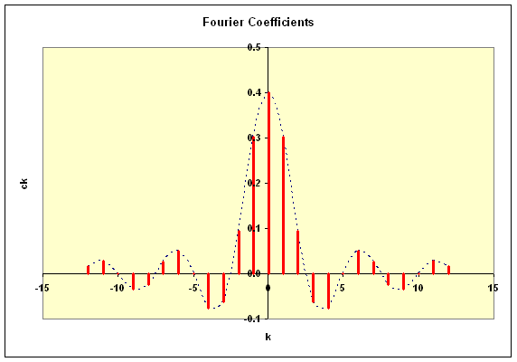
Rectangular Pulse Train
For T=100 ms, τ=40 ms, & A=1v, Fourier coefficients are:
Notes:
Here is a graphical view of the Fourier coefficients. Notice that the maximum coefficient is the dc component c0=0.4. Zero coefficients occur for all terms where 0.4πk=multiple of π, or for all 0.4k that are integers. That happens for all k that are multiples of 5.

Slide 8
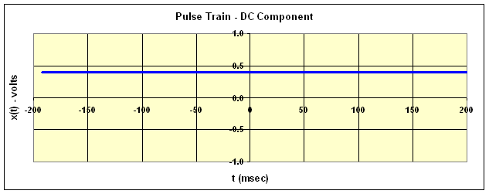
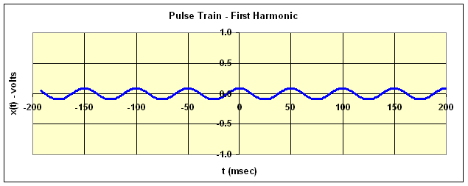
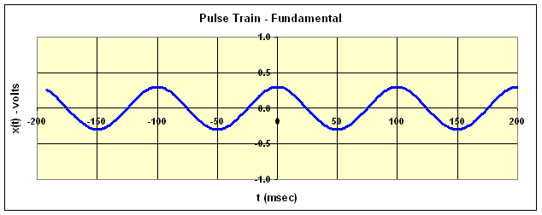
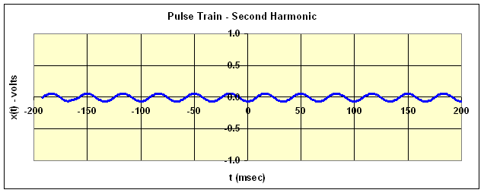
Rectangular Pulse Train
Notes:
Here is the time domain view of the Fourier terms. The real part of the Fourier terms are shown plotted for k=0,1,2 and 3. The fundamental is at frequency f=1/T= 1/100ms= 10 Hz. The first harmonic is at 20 Hz. The second at 30 Hz, and so on.
Of course, there is an imaginary part to each of the terms also. When these are combined with the terms for c(-k) the imaginary parts cancel each other and we are left with the real component only.

Slide 9
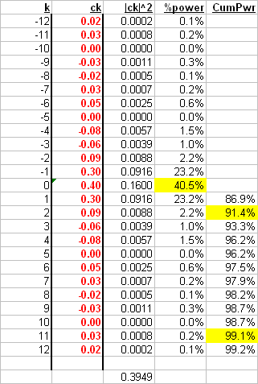
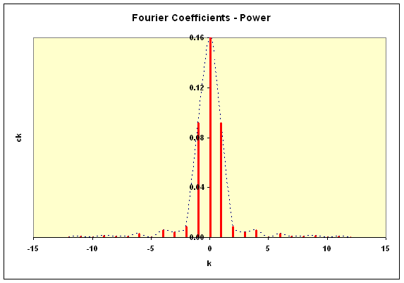
Rectangular Pulse Train
Notes:
Here is a graphical view of the power in each of the Fourier coefficients. Not all rows in the actual spreadsheet are shown here due to space limitations. Since the power exists only at discrete frequencies the frequency spectrum is known as a line spectrum.
Notice that the dc component has 41% of the power. The dc, fundamental and first harmonic components contain more than 91% of the power. Harmonics beyond the 11th contain less than 1% of the total signal power.

Slide 10
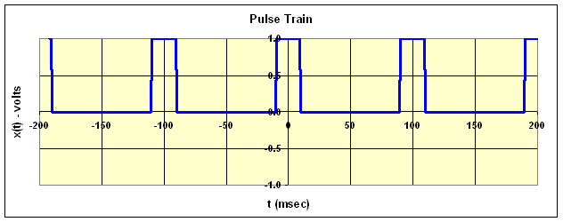
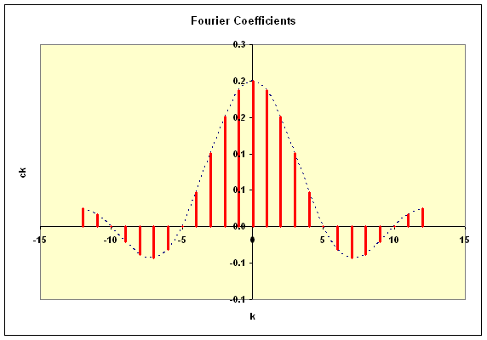
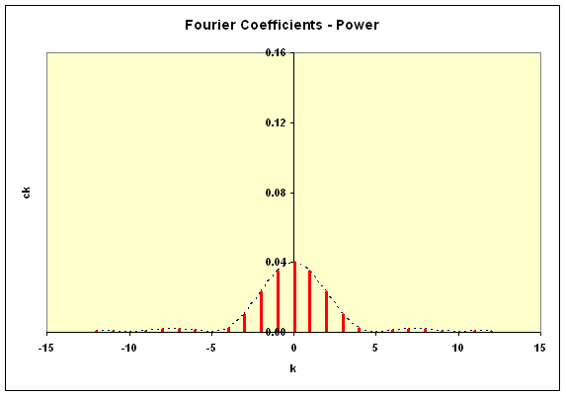
Rectangular Pulse Train
Notes:
If the pulse width is decreased to 20 msec, the spectrum spreads out as shown here. Now only about 20% of the power is in the dc component. This and the fundamental and first harmonic account for only 80% of the power now.
As the coefficient values depend only on the ratio of τ and T (aka duty cycle), increasing the period T has the same effect as decreasing pulse width τ.

Slide 11
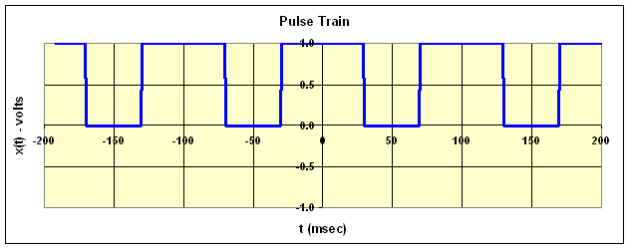
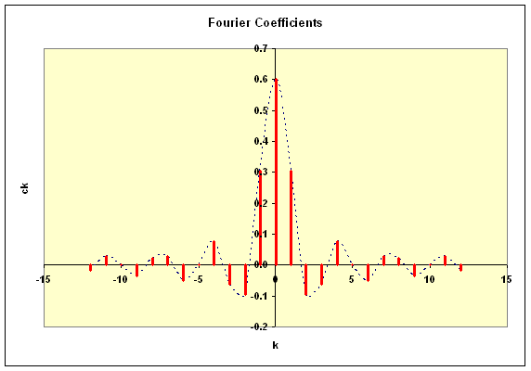

Rectangular Pulse Train
Notes:
On the other hand, if the pulse width is increased to 60 msec, the spectrum narrows as shown here. 61% of the power is in the dc component and the first three components account for 94% of the total power.

Slide 12
Aperiodic Signals
Notes:
Lets turn now to aperiodic (or non-periodic) signals.

Slide 13
Fourier Transform
Fourier Transform of an analog signal x(t):
Inverse Fourier Transform:
Note: angular frequency ω=2πν is in radians/sec, whereas ordinary frequency ν is in Hz.
Notes:
In a convenient mathematical quirk, aperiodic signals may be analyzed as periodic signals with an infinitely large period T. The Fourier series expansion then morphs into the Fourier transform.

Slide 14
Discrete Time Fourier Transform
DTFT or Fourier Transform of a discrete-time signal x(nT):
Note that this transform has limited utility since:
  X(ω) is a continuous function of angular frequency ω.
  Summation requires an infinite length sequence x(nT).
Notes:
Unlike analog signals, discrete time signals are defined only for certain values of t. For these signals, the Fourier transform morphs into the discrete time Fourier transform. Due to the reasons stated here, this transform is of limited value in DSP applications.

Slide 15
Discrete Fourier Transform
DFT is the Fourier transform of a finite duration discrete-time sequence x(n) of length N:
Inverse DFT is:
Notes:
By limiting the analysis to duration limited signals, the discrete-time Fourier transform morphs into the discrete Fourier transform or DFT. The DFT is itself a duration limited sequence of the same length as the original. Note that the DFT does not have the computational limitations of the DTFT.

Slide 16
Discrete Fourier Transform
DFT & IDFT can be expressed in terms of twiddle factors W:
Notes:
It is convenient to express the DFT and its inverse in terms of the so-called twiddle factors W.

Slide 17
Discrete Fourier Transform
Twiddle factor symmetry property:
Twiddle factor periodicity property:
Notes:
The symmetry and periodicity properties of the twiddle factors come in handy.

Slide 18
Discrete Fourier Transform
The DFT equation can be written as a matrix multiplication:
Notes:
Here the DFT is expressed as a matrix multiplication.

Slide 19
Discrete Fourier Transform
Using signal vector x and the twiddle factor matrix W, gives the DFT vector X:
Notes:
Here the DFT is expressed in vector notation.

Slide 20
Discrete Fourier Transform
The IDFT in vector notation is:
Notes:
Here the Inverse DFT is expressed in vector notation with the asterisk denoting complex conjugate.

Slide 21
Fast Fourier Transform
Notes:
We will now study the FFT.

Slide 22
Fast Fourier Transform
DFT has a large computational burden:
Number of multiplies:
    N equations * N terms/equation * 4 multiplies/term = 4N² multiplies.
    (assuming 2π/N is pre-calculated & sin/cos are from lookup tables)
Notes:
The DFT is computationally intensive. For example, it requires approximately 4N² multiplications. For N=1024, that is about 4 million multiplies. And that does not even count the additions and sin/cos lookup. The FFT is a way to get the DFT with far fewer computations.

Slide 23
Fast Fourier Transform
Decimation-in-Time FFT:
    Divide the sequence x(n) into two sub-sequences xe(m) and xo(m).
    xe(m) contains the even numbered terms of x(n).
    xo(m) contains the odd numbered terms of x(n).
    Apply DFT to the sub-sequences and combine to get DFT of x(n).
Notes:
For a decimation-in-time FFT, the sequence is divided into two sub-sequences – one containing the even numbered terms and the other the odd numbered terms.

Slide 24
Fast Fourier Transform
Decimation-in-Time FFT:
Notes:
Working through the math shows that DFT of x(n) can be computed as a linear combination of the DFT of the even and odd sub-sequences, for k values up to M-1. What about the rest of the k values?

Slide 25
Fast Fourier Transform
Notes:
Separating the computation into two parts – k less than M and k>=M – shows that the DFT of x(n) can be computed as a linear combination of the DFT of the even and odd sub-sequences, for all k values.

Slide 26
Fast Fourier Transform
XE(k)
X(k), k=0,1,…,M-1.
XO(k)
W^{k}_{N}
X(k), k=M,M+1,…,2M-1.
-1
Number of multiplies:
    log₂N stages * N/2 butterflies/stage * 4 multiplies/butterfly = 2Nlog₂N.
    (assuming 2π/N is pre-calculated & sin/cos are from lookup tables)
Notes:
The FFT computation can be represented as a butterfly network as shown here. The number of computational operations needed for the FFT is of the order NlogN vs. N*N for the DFT for a savings of the order of N/logN. For N=1000, this is about a factor of 100!

Slide 27
Thank you.
Notes:
That’s it for this week’s presentation.
Thank you.

